Slide 1





Notes:
If you use this template, please make a copy with your school name to preserve the template and RENAME the file with your school name or initials.
You may want to customize this slide with a Welcome to your School’s Title I Night - or any special instructions, etc.. I’ve included some images along the sides in case you’d like to use any of them.

Slide 2



Hartford Sylvia Encinas Elementary
Annual Title I Meeting
Thursday August 4th 2022
Notes:
If you use this template, please make a copy with your school name to preserve the template and RENAME the file with your school name or initials.

Slide 3
Agenda
Schoolwide Title I
District Adopted Curriculum
Assessment
Parent Involvement Policy
School/Home Learning Compact
A-F School Letter Grades
Questions

Slide 4

Schoolwide Title I
To qualify for a Schoolwide Program:
  Each school must have a minimum of 40% of their students receiving free or reduced-price
  Title I federal funds are used to provide supplemental program services to all students.
Each school completes the following annually:
  Comprehensive Needs Assessment
  Root Cause Analysis
  Integrated Action Plan

Slide 5

District Adopted Curriculum
READING
MATH
THE DISTRICT HAS ALIGNED ITS CURRICULUM RESOURCES TO THE ARIZONA ENGLISH LANGUAGE ARTS STANDARDS
  K-5 HMH Into Reading
  6-12 Savvas My Perspectives
READING INTERVENTION MATERIALS
  K-3 Fundations
  4-6 Just Words
  7-12 System 44 and READ 180
  Lexia
THE DISTRICT HAS ALIGNED ITS CURRICULUM RESOURCES TO THE ARIZONA MATHEMATICS STANDARDS
  K-6 McGraw-Hill My Math, HMH Go Math
DISTRICT MATH INTERVENTION MATERIALS
  K-6 MobyMax
  7-12 Mathspace

Slide 6
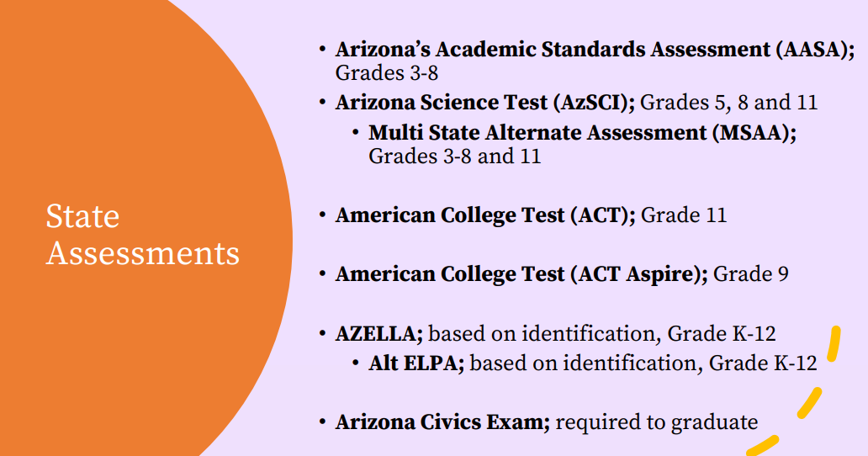
Student Assessments

Slide 7
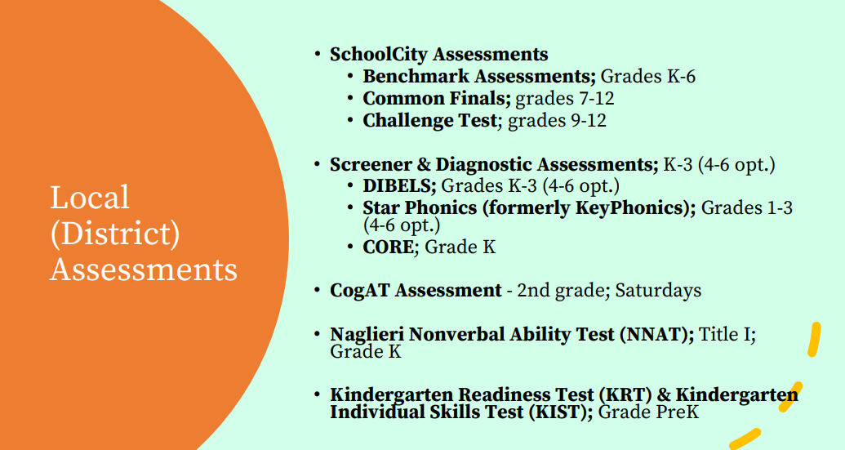
Student Assessments

Slide 8

School/Home Learning Compact
The School/Home Learning Compact serves as a commitment from all stakeholders that the education of the student is a priority.
  The compact outlines responsibilities for the parent, student, teacher, and principal/district.

Slide 9
Parent Involvement Policy
The Chandler Unified School District supports and encourages parent involvement and is committed to bringing quality programs to the children of the district.
Chandler Unified School District offers the following for parents:
  Annual Title I meeting
  Provide opportunities for regular meetings for parents
  Provide information to parents in an understandable and uniform format
  Provide a timely notice when their child has been assigned to a teacher who does not meet Arizona’s certification requirements
  Information regarding the professional qualifications of their child’s classroom teachers
  Opportunities to participate in planning and feedback regarding school goals and plans

Slide 10
School Achievement
The State will assign A-F Letter Grades for the 2021-2022 school year this fall (October/November anticipated date, subject to change, per the State).
*Letter grades will be available on the Arizona Department of Education website.

Slide 11
Our School Goals
Goal #1 | Goal #2
Goal #1 Support ALL students in their academic growth | Goal #2 Here Build and cultivate home/school/community relationships to support our student and their families
Our Need(s) is/are… To differentiate instruction for ALL students to ensure we are meeting the needs of everyone | Our Need(s) is/are… To create an inclusive learning environment, using community support, that extends beyond the school day to meet the needs of the entire family.
Our Desired Outcome(s) is/are… Students will show growth towards mastery of the standards | Our Desired Outcome(s) is/are… Students' basic needs will be met so they are prepared for learning Community resources will be connected to families to support their needs
Key activities include… Weekly team PLC meetings Tiered instruction for math and Ela Math and Reading Coaches and Specialist to support both Teachers and Students Highly-Qualified paraeducators to support teachers | Key activities include… PTO / Site Council meetings Community Engagement Roundtable meetings Further Cultivate and expand community partnerships Leader in Me teaching and engagement
Success will look like… Students growth towards mastery of the standards Students mastering the standards | Success will look like… Continued participation at school events
Notes:
If you need to split this information into 2 slides or create an additional slide for goals because it is too crowded, please do.

Slide 12
What Title I Means to Us
Title I funds support our students by…
Allowing us to hire full-time math and reading coaches and specialist
Title I funds support our teachers by…
Allowing us to hire a full – time Family Liaison
Title I Supports our families by…
Allowing us to hire a full-time family liaison
Allowing us to provide a family resource center
Notes:
This is your time to share the exciting things you get to do for students because of your Title I status… examples: tutoring programs, the PD that teachers attend, any PLCs that they are participating in to support students, the materials, personnel and/or professional resources you have access to (interventions/positions, etc.), the parent engagement opportunities they can participate in and possibly any literacy/math/etc. opportunities you might be offering this school year… - these are just some ideas. :-)

Slide 13




Questions? …
Thoughts? …
Next steps? …
Needs? ...

Slide 14




Thank you for coming
Gracias por venir

